Slide 1

Methodology Review

Slide 2
Agile Roles
Product Owner
Crucial role in defining and prioritizing user stories based on stakeholder needs and market demands.
Scrum Master
Facilitate team discussions, removing impediments, and ensuring adherence to Scrum principles.
Development Team
Adaptability and problem-solving skills

Slide 3
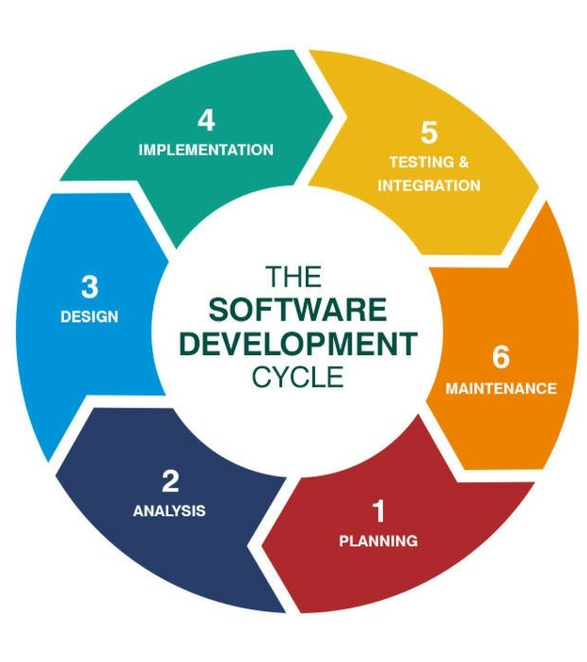
Software Development Life Cycle
1) Planning
Project stakeholders define the scope, objectives, and requirements of the software project.
2) Analysis
The development team works with stakeholders to gather requirements for the system.
3) Design
The development team creates the architectural and technical design for the software system.
4) Implementation
Developers write code according to the specifications outlined in the design documents
5) Testing & Integration
Software undergoes various testing activities to identify and resolve defects or bugs.
6) Maintenance
Ongoing support and enhancements to the software after it has been deployed.

Slide 4
Waterfall
Sequential Process: The Waterfall method follows a linear and sequential approach to software development, where each phase is completed one after the other in a predetermined order.
Predictive Planning: In Waterfall, the entire project is planned upfront, and requirements are defined and documented extensively at the beginning of the project.
Fixed Scope and Timeline: Waterfall projects usually have fixed scope, timeline, and budget.
Emphasis on Documentation: Waterfall places a strong emphasis on documentation, with detailed requirements, design documents, and test plans created at each stage of the development process.
High Risk of Late Surprises: Since testing occurs towards the end of the project, there is a higher risk of discovering defects or issues late in the development lifecycle, which can lead to delays and increased costs.
Agile
Iterative and Incremental: Agile methodologies, such as Scrum and Kanban, emphasize iterative and incremental development, with work broken down into small, manageable increments (Sprints) that are delivered frequently.
Adaptive Planning: Agile embraces change and uncertainty by allowing for flexible planning and adaptive decision-making throughout the project.
Collaborative Approach: Agile encourages collaboration among cross-functional teams, with frequent communication and collaboration between developers, testers, product owners, and stakeholders.
Continuous Feedback: Agile emphasizes the importance of continuous feedback and validation, with regular demonstrations of working software to stakeholders and users.
Reduced Risk: By delivering working software in small increments and incorporating feedback early and often.
Vs.

Slide 5
Which methodology to use?
Project Requirements Stability:
In projects where requirements are well-defined and unlikely to change significantly, the Waterfall approach may be more suitable.
Degree of Uncertainty:
Agile methodologies, with their iterative and adaptive nature, are better suited for projects with high levels of uncertainty or evolving requirements.
Customer Involvement and Feedback:
Agile methods emphasize regular interaction with stakeholders and continuous feedback, which is valuable when developing software that must closely align with customer needs and preferences.
Time-to-Market and Speed of Delivery:
Agile methodologies typically enable faster delivery of working software through iterative development and incremental releases.

Slide 6
Questions?

Slide 7
The End

